Slide 1
Gamma Sterilization Packaging Simulation
Ann Liu-Ferrara
July 17, 2020

Slide 2
Objectives
Examine the impact of box height to dose distribution given density, Dose Uniformity Ratio (DUR)
1
Optimize box height in a sterilization load within the range of maximum and minimum doses
2
Reduce gamma sterilization cost

Slide 3
Background of Current Package Configurations
Reduce sterilization costs is a constant pressure. This is especially true for validation and process verification for new products and materials, which can be complex and time-consuming.
Optimizing packaging size in a sterilization load under pre-validated settings streamlines production and reduce costs.
The current pre-validated settings contain density, DUR, and box height. The simulation will run 10 times and find a surface response curve under given conditions.
Current pre-validated settings and ratio is as below, only box height of 49 will be used in the simulation.
This stimulation cost is assumed $.05 per load for demonstration purposes, and 10k loads per month for this package.
height | density | DUR | ratio
39 | 0.31 | 2.08 | 8
39 | 0.31 | 2.13 | 1
49 | 0.25 | 1.6 | 1

Slide 4
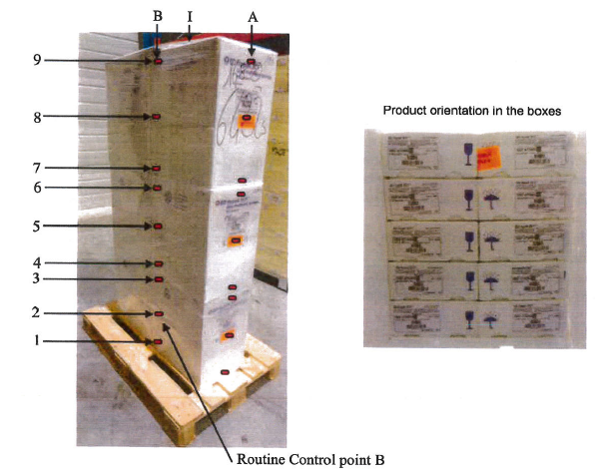
Research Question
With pre-validated setting on density and DUR, will the increase of box height reduce sterilization costs?
It is assumed that the increase of box height allows more products to be put on the load, and density remains unchanged.

Slide 5
Flow Chart
start
end
no
Set seed & initialize index:
Run num i = 1
i = i + 1
yes
i<10?
Set DOE for experimental run:
density: [.25]
DUR: [1.6]
height: [49]
yes
no
i = i + 1
i<10?
Calculate change of cost by changing the package
5

Slide 6
Variables & Parameters Defined in the Simulation
Sets
i : box type /density, DUR, height/
t : DOE scenario /1*10/
Design of Experiments Parameters (DOE)
dose: y
box height :h
box bulk density: d
DUR: u
Deterministic distribution used
Deterministic Estimates:
$/load: dollar per sterilization load

Slide 7
Dose BoxHeight BoxBulkDensity DUR
Dose Linear Equation:
y = 1111 - 4158*d
- 1.113*h
- 493.6*u
+2.956*d*h
+1911*d*u

Slide 8
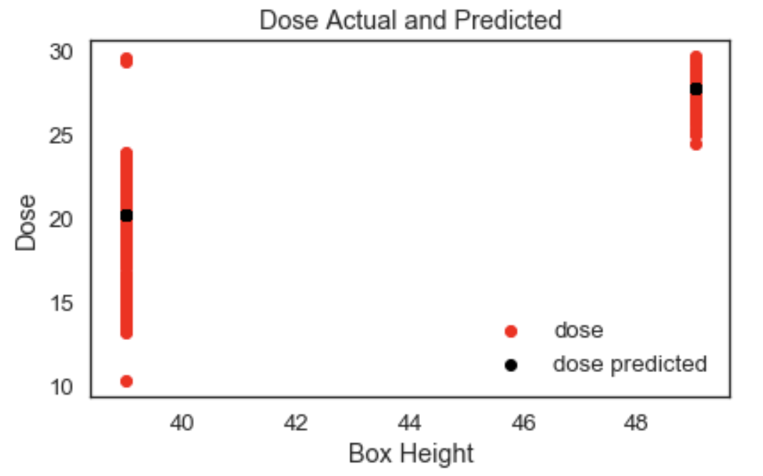
Dose Actual vs Predicted The back dot is predicted value for box height 49.

Slide 9
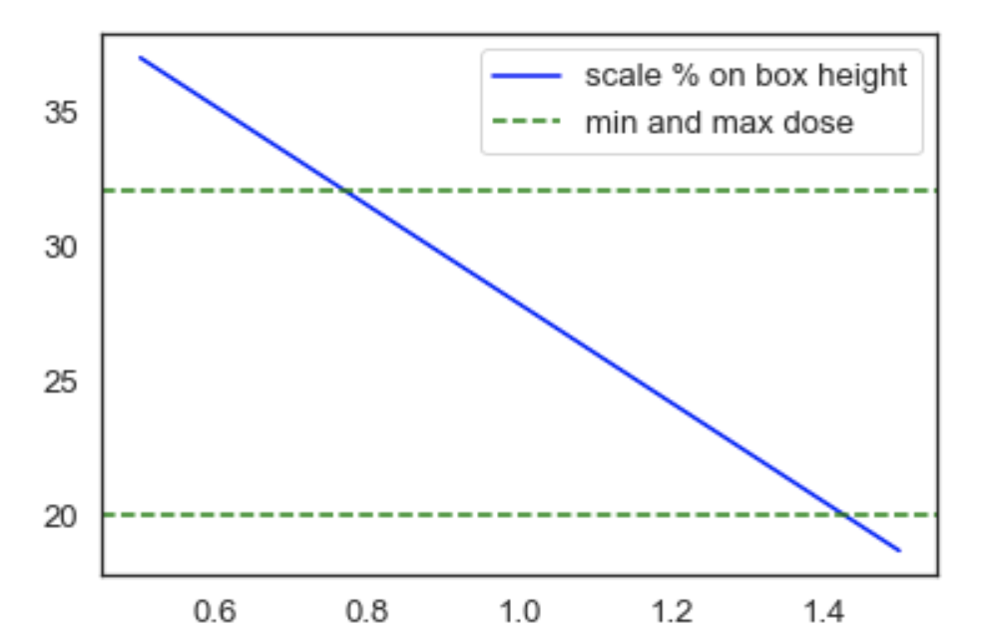
Method & Results Run 10 iterations by scaling up box height 50% to 150%, and a portion of dose distributions are within the range of min and max doses. Only the scale greater than 1 is desirable outcome. The model line crosses min dose line at 1.42, it is the best outcome that box height can scale up in the simulation under given conditions.

Slide 10
Validation & Verification
Comparing means of dose generated from the model to the original dataset provides a form of internal validation. The results of means are 19.47 and 19.76, the predicted doses is close to actual doses.
A max box height that scales up by 42% is plugged back to the model, and dose is 20.12, in the minimum and maximum dose range (20, 32), it provides external validation. Only scales greater than 1 is desired.

Slide 11
Cost Savings
Assume cost per load is $.05, and 100k loads run per month. By increasing 42 percent of box height, it equals 42 percent of cost savings, which is 2100 dollars/month.

Slide 12
Conclusion
The simulation illustrates that box height increases 42% and still is under given requirement on dose range. The box height jumping from 49 to 69.58 leads to huge cost savings, $2100 per month on one sterilization packaging setting.

Slide 13
Limitation & Discussions
This simulation works as an oversimplified prove of concept. More cases should be tested using different DUR and BoxBulkDensity.

Slide 14
References:
Crawford M.. (2019). Revisiting the End: A Packaging and Sterilization Update,
https://www.mpo-mag.com/issues/2019-06-01/view_features/revisiting-the-end-a-packaging-and-sterilization-update/
Downey, A. B. Modeling and Simulation in Python. Version 3.4.3. Green Tea Press
Fulton, L. V., Perry, M. J., Wood, S. J., & Bewley, L. (2010). Engineering the New Combat Support Hospital. The Journal of Defense Modeling and Simulation, 7(1), 25–37. https://doi.org/10.1177/1548512909355290

Slide 15
Thank you
Acknowledgement:
Dr. Larry Fulton

